Slide 1


Implementation of NLP methods on Federal Reserve Bank Beige Books
ADEC 7430 Final Project

Slide 2
Objective
Assess Federal Reserve Bank Beige Books from 1996 - 2021 and categorize general economic sentiments imbued from them using Natural Language Processing (NLP) methodologies

Slide 3
Contents
Featurization - Bag of Words(Aarjan)
Word Cloud(Shanshan)
TF-IDF(Oscar)
Cosine similarity(Maombi)
NLTK (Yusheng)
Stopwords, stemming, tokenization(Aarjan)
One hot encoding(used in the Bag of Words Analysis)
K- mean concept, why we choose it(Minghua)
Clustering result from the project(Shanshan)

Slide 4
Beige Books: the Summary of Commentary on Current Economic Conditions
Federal Reserve has compiled these reports since 1970, began making them public in 1983. The report is published ~8 times a year, two weeks before each FOMC meeting.
Always contains exactly 32 pages, lacks economic algorithms, data models or complicated terms. Beige Books rely upon qualitative evidence gathered through surveys of company executives, economists, and market experts by industry. The number of surveys varies by geographic size and population density.
Fed continues to publish Beige Books despite increased access to qualitative economic data due to the believe that this qualitative data is more forward-looking than qualitative data.
Advantage: Summaries are separated by Federal Bank region and industry allowing the books to arguably do a better job of highlighting geographic variations.
Disadvantage: Qualitative data cannot be safeguarded against biases as robustly as quantitative data. Needs to be viewed with a critical economic and political lens.
Notes:
https://news.medill.northwestern.edu/chicago/content-simple-but-impact-significant-for-feds-beige-book-report/
FOMC: Federal Open Markets Committee

Slide 5
Dovish vs Hawkish
Terms used to describe a central bank’s general sentiment or overall economic outlook
Used to classify how the Fed is predicted to utilize its monetary policy tools (primarily by influencing the federal funds rate) to shape the future of the US economy
Dovish: Economic policy advisor who advocates for monetary policies which stimulate economic growth. This typically takes the form of advocating for the Fed to lower federal funds rate.
Hawkish: Economic policy advisors who advocate for monetary policy which reigns in economic growth. Typically concerned with curbing inflation levels through increasing the federal funds rate.

Slide 6
Sequence of Application
Beige Books
Beautiful Soup
Corpus
Word Cloud
Tokenization
Stemming
Stopwords
Vectorization
Cosine Similarity
Major clusters across Beige Books
Beige Books separator, based on sentiments
Hierarchical
K-Means
Topic Modeling
Interactive Graphic

Slide 7
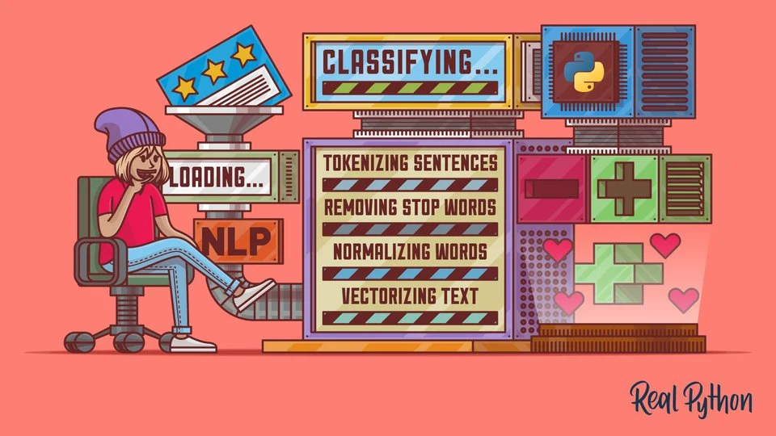
Sequence of Application
Clean Data
Bag of Words - WordCloud
Stemming, Tokenization, and Stopwords
Vectorization - TF-IDF
Distance Measure & Cosine Similarity
Clustering - Hierarchical & Partitioning
Stopword Refinement
Topic Modeling
https://realpython.com/nltk-nlp-python/

Slide 8
Concepts
Natural Language Processing (NLP)
Natural language processing is a branch of Artificial Intelligence that is concerned with giving computers the ability to understand text and spoken words in much the same way human beings can
Corpus/Corpora
Large and structured set of machine-readable texts that have been produced in a natural communicative setting
Saliency Measure
Indicates the importance or relevance of the entity to the entire document text. It is a prediction of what humans would consider the most important entities in the same text

Slide 9
Bag of Words (BoW)
Bag of Words is a Natural Language Processing (NLP) technique of text modeling
A bag of words is a representation of text that describes the occurrence of words within a document.
It can be done in two ways:
Without preprocessing
With preprocessing → Stemming and Tokenization
Featurization
Assuming we have a dictionary mapping words to a unique integer id, a bag-of-words featurization of a sentence could look like this:
Sentence: The cat sat on the mat
word id’s: 1 12 5 3 1 14
The BoW featurization would be the vector:
Vector 2, 0, 1, 0, 1, 0, 0, 0, 0, 0, 0, 1, 0, 1
position 1 3 5 12 14

Slide 10
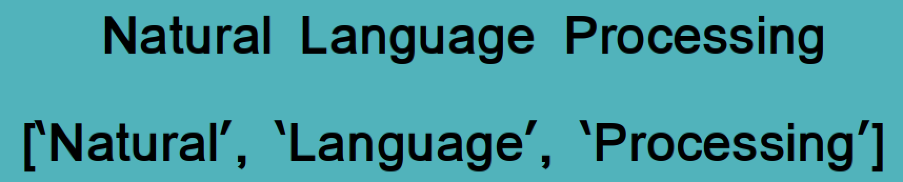
Concepts Continued….
Tokenization
Stemming
Stemming lowers inflection in words to their root forms, hence aiding the preprocessing of words
For instance, the stem of these three words, connections, connected, connects, is “connect”.
TF-IDF
Stands for Term Frequency and Inverse Document Frequency. It is a scoring measure widely used in information retrieval

Slide 11
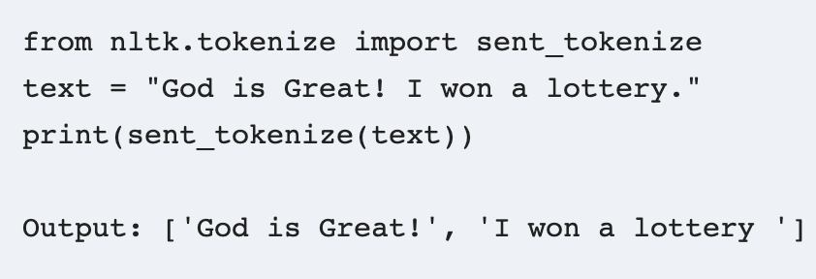
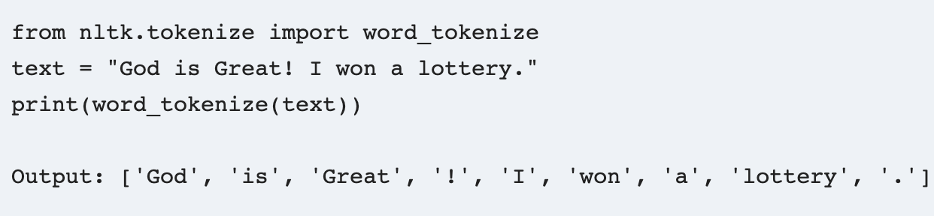
Key Terms
Tokenization
Tokenization in NLPs are generally done in two major ways:
Sentence Tokenizer
Done through sent_tokenizer
Word Tokenizer
Done through word_tokenizer
Importance:
Combination of two tokenizers can help convert string to numeric data as ML algorithms require numeric data
For e.g. calculate ratio of certain words in a particular text file
Notes:
One hot encoding was used for the creation of the corpus of words used in each process (https://towardsdatascience.com/text-data-representation-with-one-hot-encoding-tf-idf-count-vectors-co-occurrence-vectors-and-f1bccbd98bef)

Slide 12
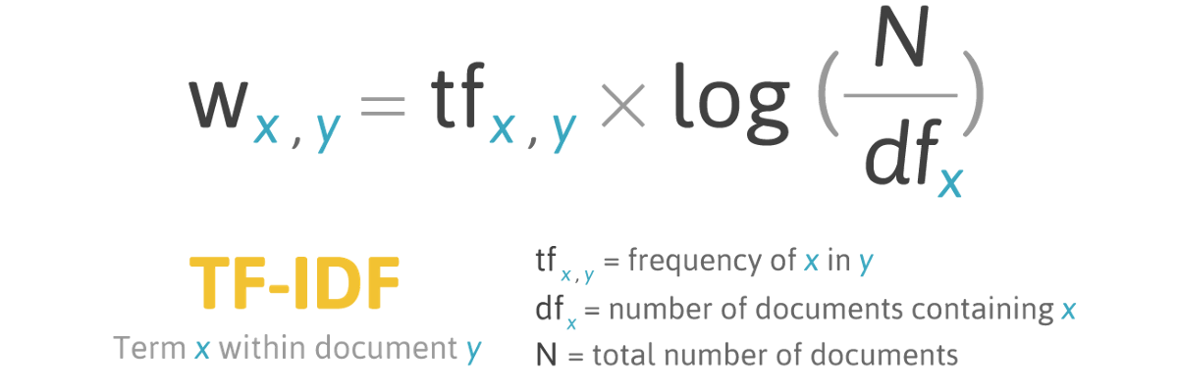
TF-IDF
Vectorization using TF-IDF (term frequency–inverse document frequency) was used by TfidfVectorizer
TfidfVectorizer uses an in-memory vocabulary (a python dict) to map the most frequent words to features indices and hence compute a word occurrence frequency (sparse) matrix
What is IDF (inverse document frequency)?
Inverse document frequency looks at how common (or uncommon) a word is amongst the corpus. IDF is calculated as follows where t is the term (word) we are looking to measure the commonness of and N is the number of documents (d) in the corpus (D).. The denominator is simply the number of documents in which the term, t, appears in.
https://www.capitalone.com/tech/machine-learning/understanding-tf-idf/
TF-IDF cannot help carry semantic meaning
TF-IDF ignores word order and thus compound nouns like “Queen of England” will not be considered as a “single unit”
TF-IDF can suffer from the curse of dimensionality
Notes:
Oscar Parra

Slide 13
Since TF-IDF weights words based on relevance, one can use this technique to determine that the words with the highest relevance are the most important. This can be used to help summarize articles more efficiently or to simply determine keywords (or even tags) for a document.
So when dealing with textual data or any natural language processing (NLP) task, a sub-field of ML/AI dealing with text, that data first needs to be converted to a vector of numerical data by a process known as vectorization. TF-IDF vectorization involves calculating the TF-IDF score for every word in your corpus relative to that document and then putting that information into a vector (see image below using example documents “A” and “B”).Once you have these vectors you can apply them to various use cases such as seeing if two documents are similar by comparing their TF-IDF vector using cosine similarity.

Slide 14
Distance Measurement and Cosine Similarity
Cosine similarity is one of the metric to measure the text-similarity between two documents irrespective of their size in Natural language Processing. A word is represented into a vector form. The text documents are represented in n-dimensional vector space
It ranges from 0 to 1. If the Cosine similarity score is 1, it means two vectors have the same orientation while a cosine similarity score of 0 means that there is no similarity between the two text or documents
Cosine similarity is can be used for recommendation systems, plagiarism detectors, and data mining.

Slide 15
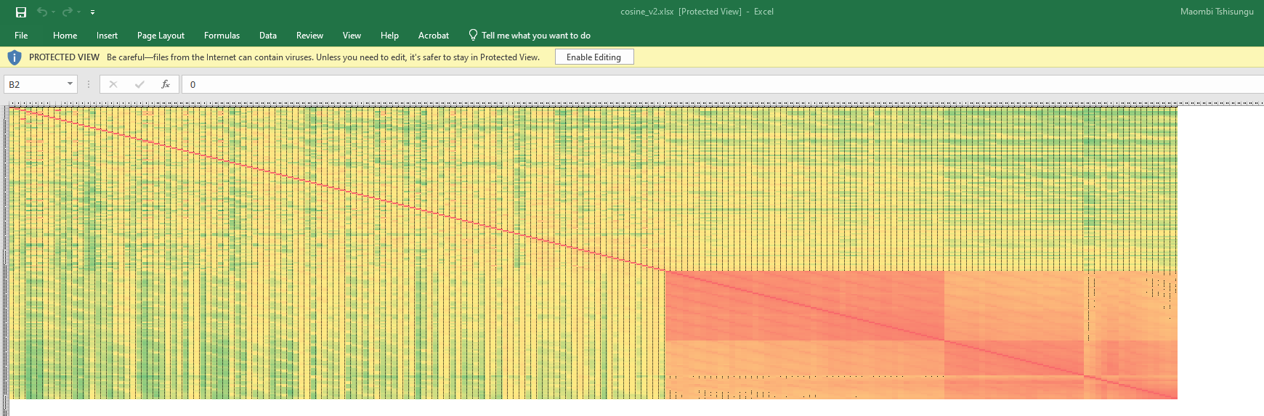

Slide 16
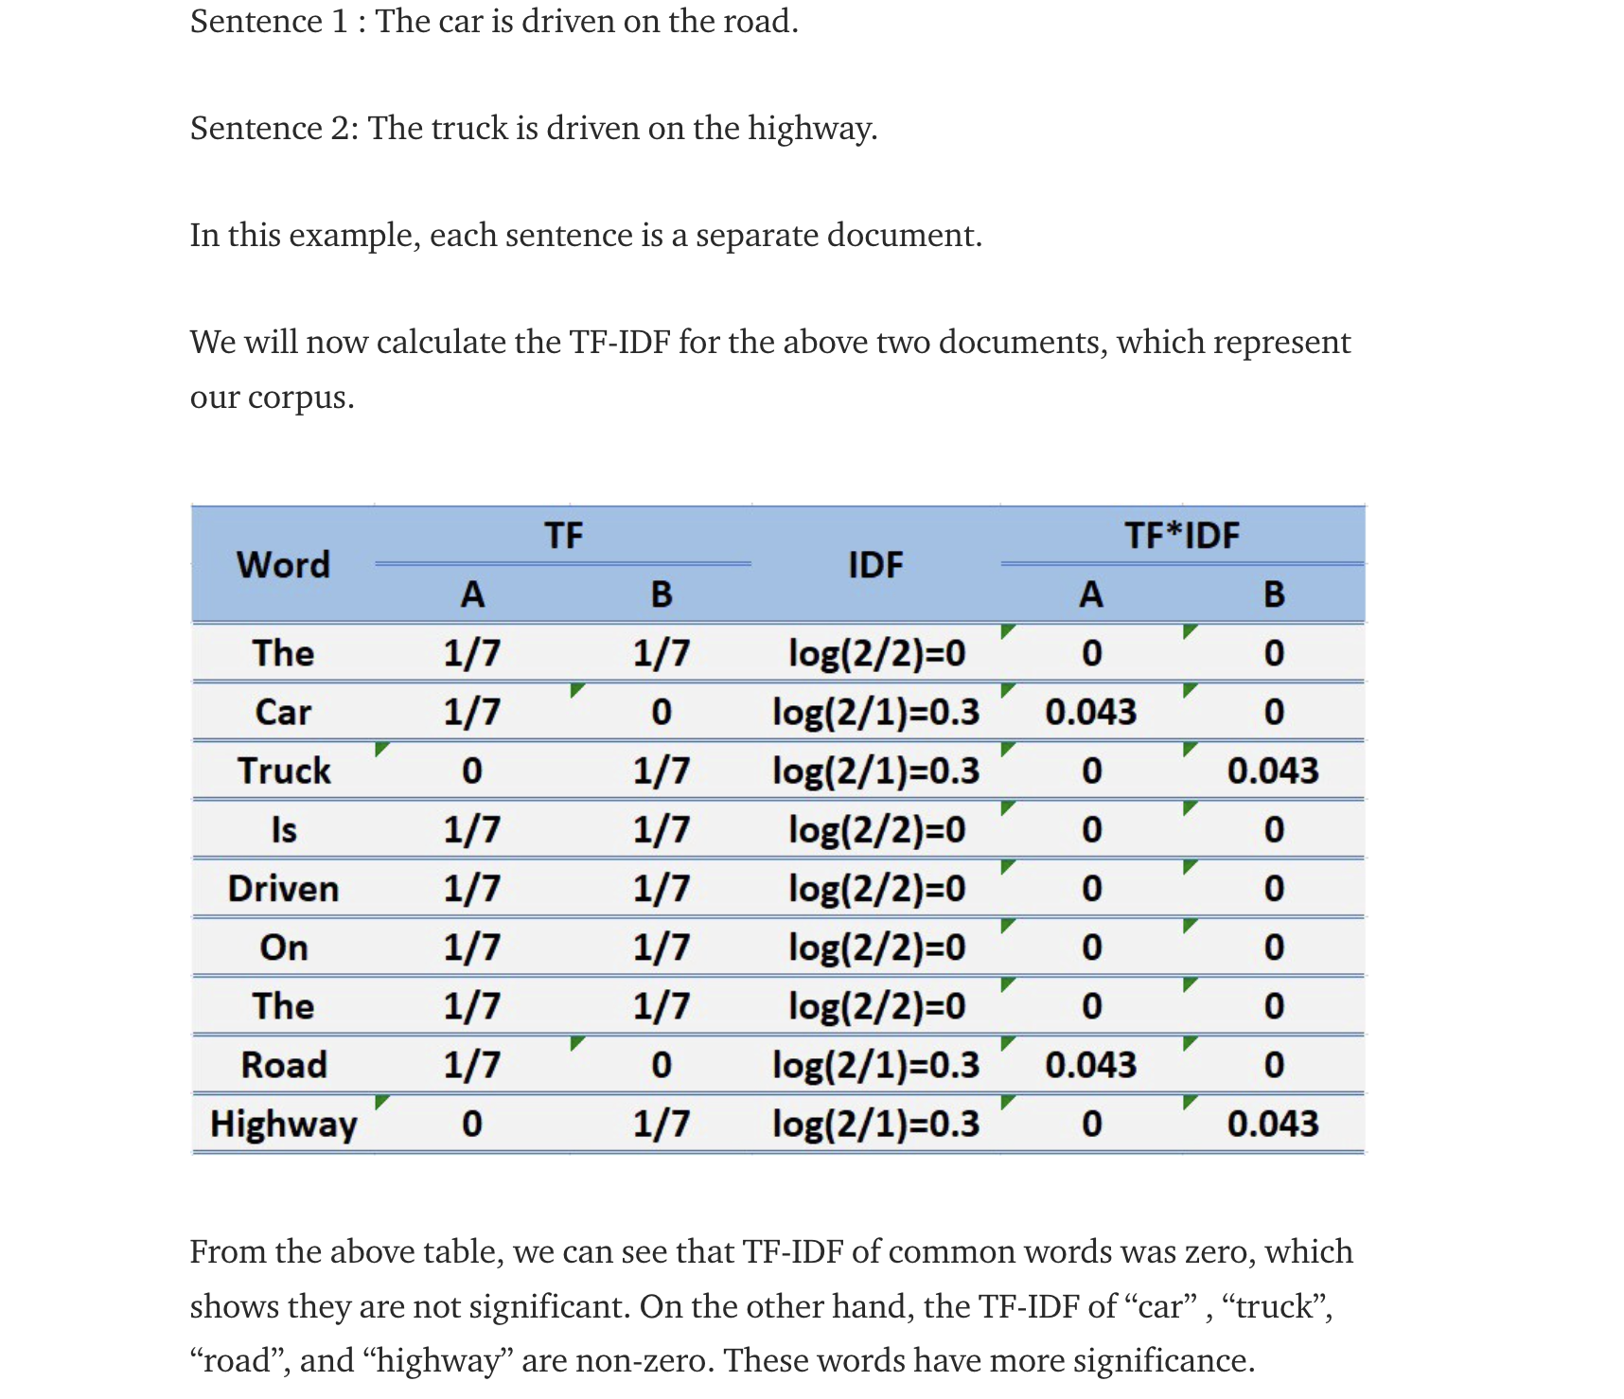
Common Words in both sentences get a score of 0, implying that they do not help distinguish sentiments

Slide 17
NLTK
The Natural Language Toolkit(NLTK) is an open source library for the Python programming language, which is suitable for the linguists and students without deep knowledge of programming to delve into computational linguistics.
NLTK consists of the most common algorithms such as tokenizing, part-of-speech tagging, stemming, sentiment analysis, topic segmentation, and named entity recognition.

Slide 18
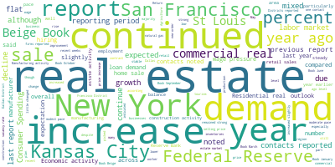
WordCloud Output
SL
Key takeaway: some important words we can see from the picture are real estate, demand, etc.

Slide 19
Word Cloud High Frequency words
SL
'real estate': 1.0,
'increase': 0.669054664382495,
'continued': 0.6500545086435134,
'demand': 0.6302756579971966,
'year': 0.5562996418003426,
'New York': 0.5432175673571095,
'report': 0.48388101541815914,
'Kansas City': 0.4824793645849556,
'San Francisco': 0.4517987852359446,
'sale': 0.44946270051393866,
'Federal Reserve': 0.4089705653325027,
'percent': 0.39651144681513784,
'year ago': 0.39230649431552717,
'commercial real': 0.39121632144525775,
'Beige Book': 0.37252764366921043,
'St Louis': 0.36380626070705496,
'contacts reported': 0.3610029590406479,
'mixed': 0.33748637283912164,
'reporting period': 0.3340601152468463,
'expected': 0.3328142033951098,
'last report': 0.3172403052484037,
'growth': 0.3030680579349011,
'Consumer Spending': 0.3007319732128952,
'due': 0.29933032237969165,
'decline': 0.28157607849244665,
'flat': 0.26553496340133936,
'although': 0.2516741940507709,
'continue': 0.24575611275502257,
'noted': 0.2452888958106214,
'labor market': 0.24077246534807661,

Slide 20
Cluster Analysis
SL
Hierarchy Cluster Analysis: A method of cluster analysis that seeks to build a hierarchy of clusters without having fixed number of cluster.
K-Means Cluster Analysis: A method of cluster analysis using a pre-specified No. of clusters.
Differences: 1) Divisive or Agglomerative vs. Distance 2) Only One cluster vs. Median or Mean
3) Arrange the Clusters into a Natural Hierarchy vs. Less Computational intensive
4) The Production of Results 5) Presentation of Results.
How to choose:
K-Means Clustering: Dense; Spherical or clump-like.
Hierarchy Clustering: Small data sets; Not clearly clustered into several categories.

Slide 21
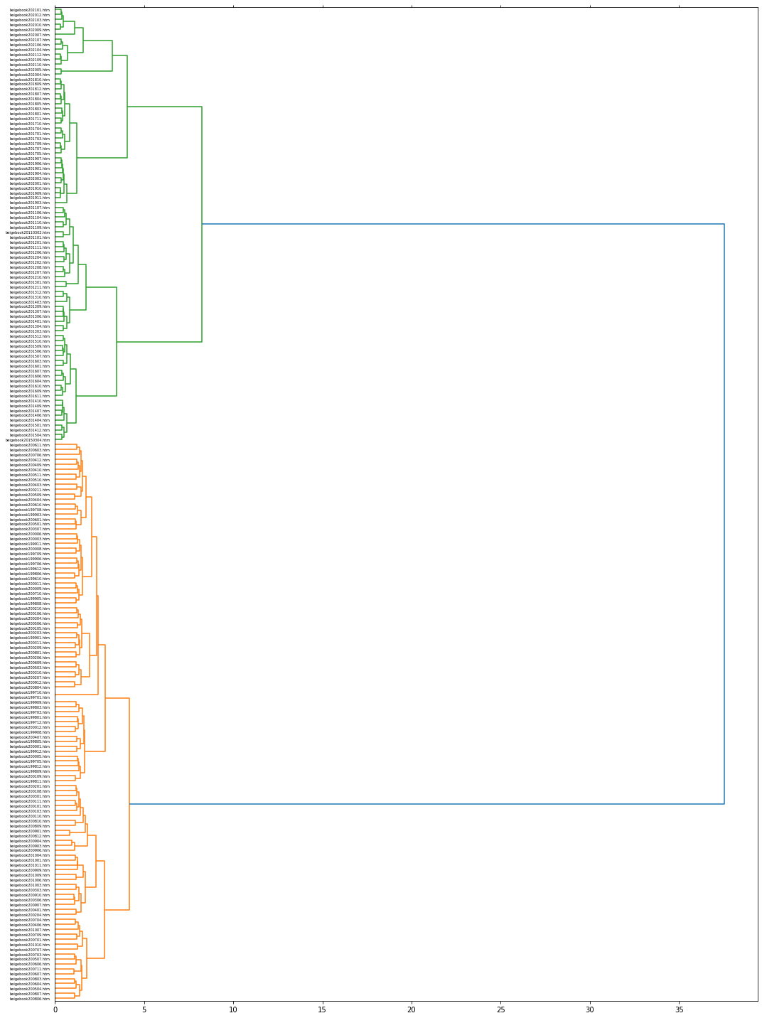
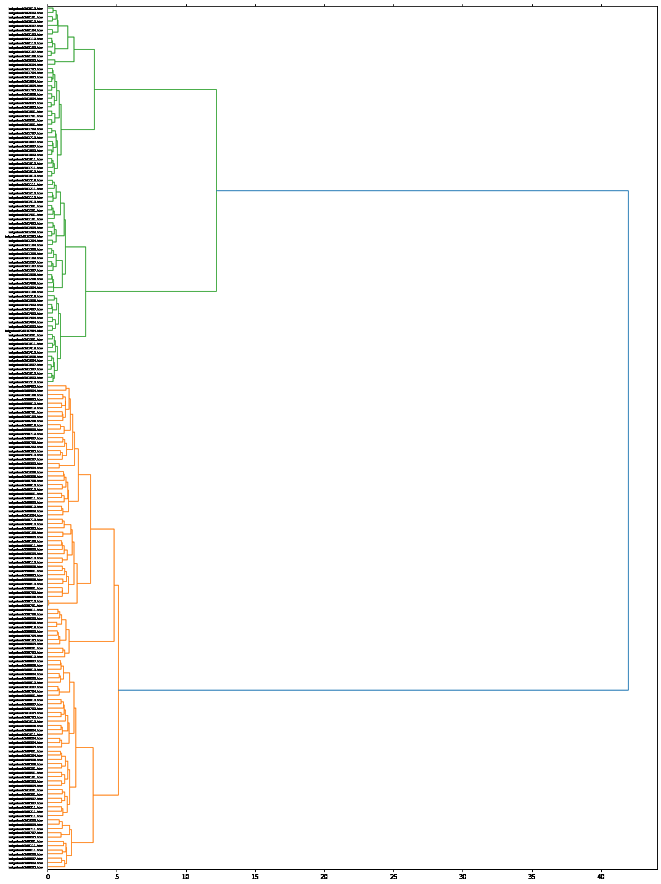
Hierarchy Cluster Analysis
SL
We can see initially the beige books are divided into 2 branches(Green & Orange), by publishing year before and after 2010.
It also gives us a hint on how many K-means clusters we might be able to use.

Slide 22
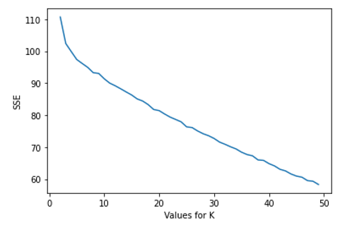
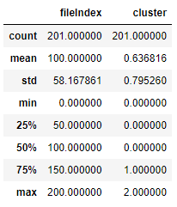
K-Means Clustering
SL
In our project: no clear elbow effect shown from the graph.
3 clusters should be efficient in this case

Slide 23
Stopword Refinement
Removed…
Common words (‘the’, ‘and’, ‘I’) preloaded in the NLTK library
Months, seasons, and time order words (weeks, year-ago, year-over-year)
Geographic regions (States, cities, some countries)
Numbers in text format
More common words (overall, whereas, use) especially ones with dual meanings (form, paper, fuels, motor)
Words not believe to contribute to the classification (telecommunication, motor, pastures, grain, cotton, field, sports, furniture)

Slide 24
Top 20 Terms per Cluster
Cluster 1:
35% Positive/ 13% Negative
'robust',
'expansion',
'grow',
'acceleration',
'supply',
'accessibility',
'policy',
'slower',
'brisk',
'temporary',
'strengthen',
'rose',
'difficulty',
'tightening',
'stronger',
'boosted',
'favorable',
'increases',
'problems',
'damage'
Cluster 2:
25% Positive/23% Negative
'rose',
'decrease',
'grew',
'balance',
'supply',
'optimistic',
'revenues',
'grow',
'increases',
'increases',
'robust',
'uncertainty',
'average',
'anticipated',
'fell',
'stronger',
'modestly',
'increases',
'traffic',
'strengthen'
Cluster 3:
16 % Positive/ 36% Negative
'decrease',
'sluggish',
'reduced',
'deterioration',
'stability',
'tightening',
'weaker',
'policy',
'accessibility',
'rose',
'subdued',
'increases',
'layoffs',
'strengthen',
'boosted',
'fell',
'downward',
'demand',
'reduction',
'favorable'
Decreasing order of relevance
Notes:
Tf vectorizer
Preserve context
· We viewed k-means clustering as the most appropriate method for the classifying of beige books bc it allowed us to leverage our knowledge of the text data (in that hawkish and dovish views should be present in each book) as well as our desire to reach a grouped result for this unlabeled text data
· While this was not technically a sentiment analysis, the overall felling of the 100 words selected to group as well as the top 10 representative words of each cluster were reviewed to discern it’s the overarching theme at play in each class
· Cluster 1 resulting in having 35% representative words being positive while only 13% are negative…..
· While ideally KMeans clustering seeks to minimize the within-cluster variation, the desire to keep intact the context attached to words that were easy to obtain a sentiment from guided us to not seek high percentages of positive or negative sentiments.

Slide 25
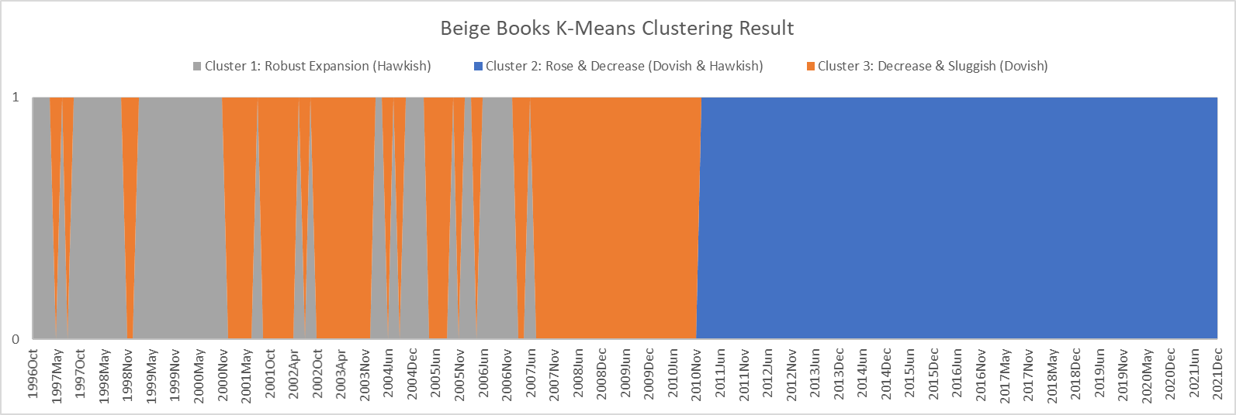
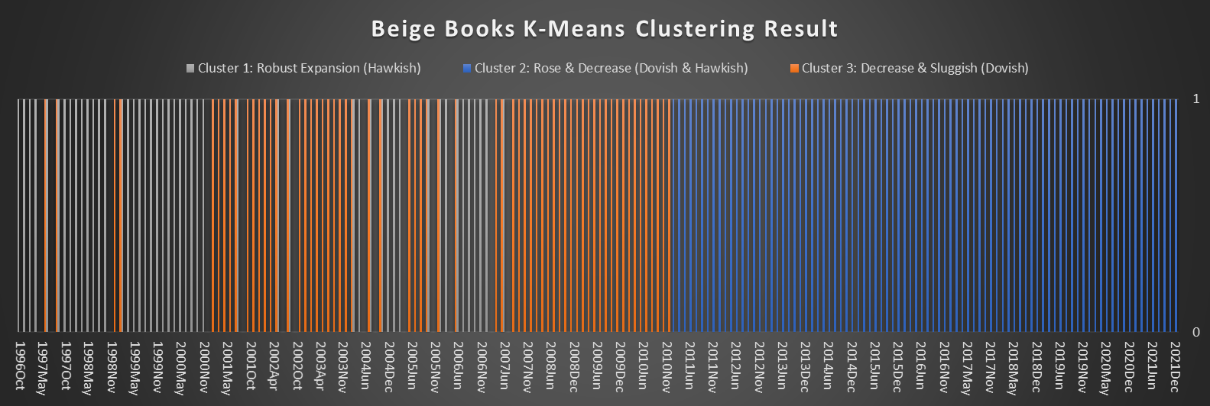
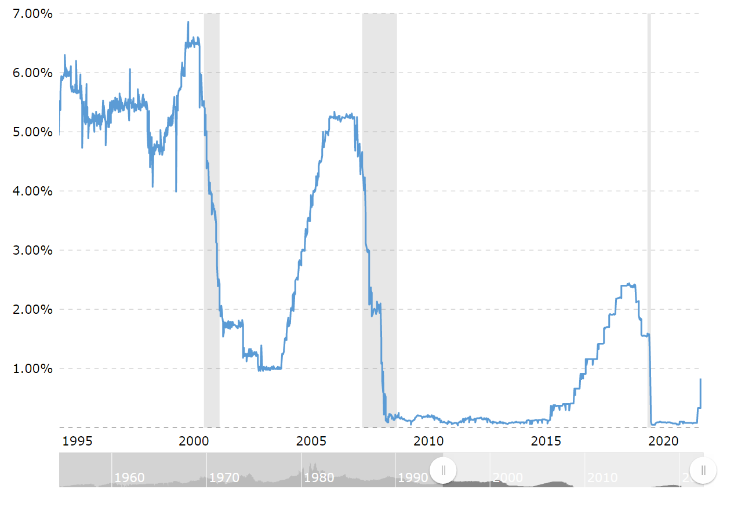
Federal Funds Exchange Rate
Comparing Macroeconomic Trend with the Beige Book Clustering Result
Hawkish: 1996 - 2002 & 2004 - 2007
Both: 2011 - 2021
Dovish: 1997 - 1998 & 2000- 2010
Notes:
K mean smallest variation - context

Slide 26
Questions and Comments

Slide 27
Bibliography
Foster, S. (2019, January 29). Content simple, but impact significant for fed's Beige book report. Medill Reports Chicago. Retrieved May 7, 2022, from https://news.medill.northwestern.edu/chicago/content-simple-but-impact-significant-for-feds-beige-book-report/
Gordon, J. (2022, April 25). Dove &amp; Hawk (monetary policy) - explained. The Business Professor, LLC. Retrieved May 7, 2022, from https://thebusinessprofessor.com/en_US/economic-analysis-monetary-policy/dove-monetary-policy-definition

